Slide 1
Understanding Career
Aspirations of Gen-Z
Jayati Singh
3,611
9
5W1H
Survey Responses
Milestones
Framework Used

Slide 2
Project Roadmap
9 Milestones from Problem Statement to Final Presentation
1
Problem Statement
2
Platform Ratings
3
Data Collection
4
Data Cleaning
5
EDA
6
SQL Analysis
7
Excel Dashboard
8
Power BI Dashboards
9
Presentation

Slide 3
Milestone 1
Problem Statement Documentation
Understanding the Gen-Z career crisis using the 5W1H Framework

Slide 4
Problem Statement — 5W1H Framework
What, Why, Who, When, Where, How
WHAT
WHY
WHO
Gap between what Gen-Z expects from jobs and what employers actually offer.
Social media creates unrealistic expectations; workplaces still follow traditional practices.
Gen-Z employees, employers, HR professionals, and business stakeholders.
WHEN
WHERE
HOW
Problem starts within first few months of employment, worsened post-COVID.
Most visible in IT, Banking, BPO sectors and large corporates globally.
Flexible work, regular feedback, growth opportunities, and open communication.

Slide 5
Milestone 2 & 3 — Platform Ratings & Data Collection
Contributing feedback + Collecting Gen-Z survey data
Milestone 2 — Platform Ratings
Milestone 3 — Data Collection
Contributed ratings and reviews to KultureHire's learning platform as part of the learnternship experience.
Created a Google Form to collect Gen-Z career aspiration data. Survey was shared via LinkedIn and social media.
Course Content
3,611
India
19
Mentor Support
Total Responses
Primary Country
Survey Questions
Platform UX
Questions covered: Career aspirations, work environment, salary expectations, social impact values, manager preferences, and more.

Slide 6
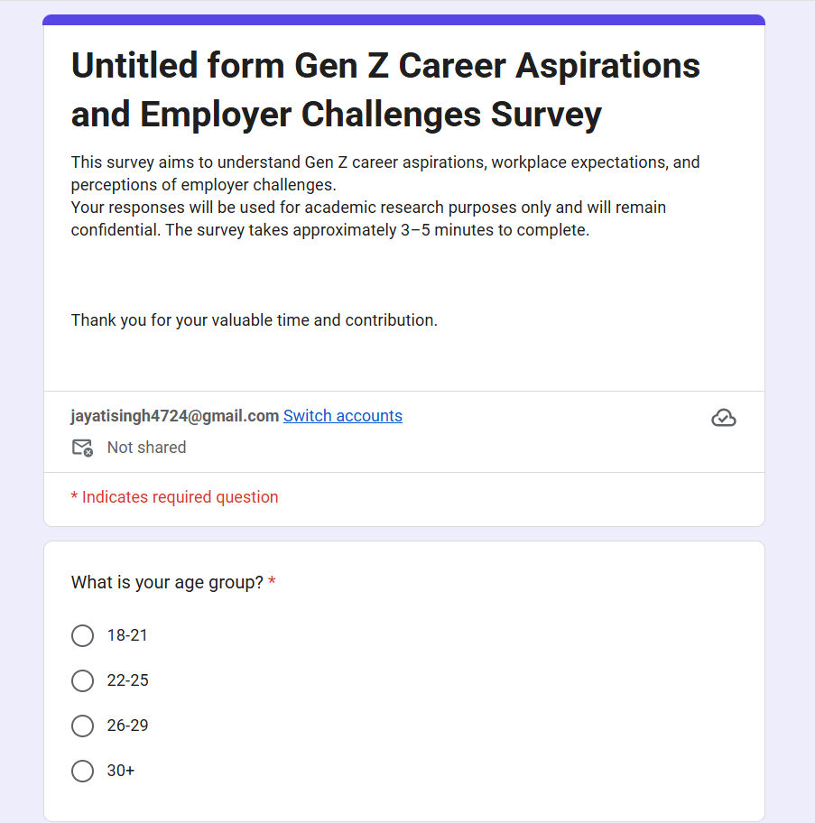
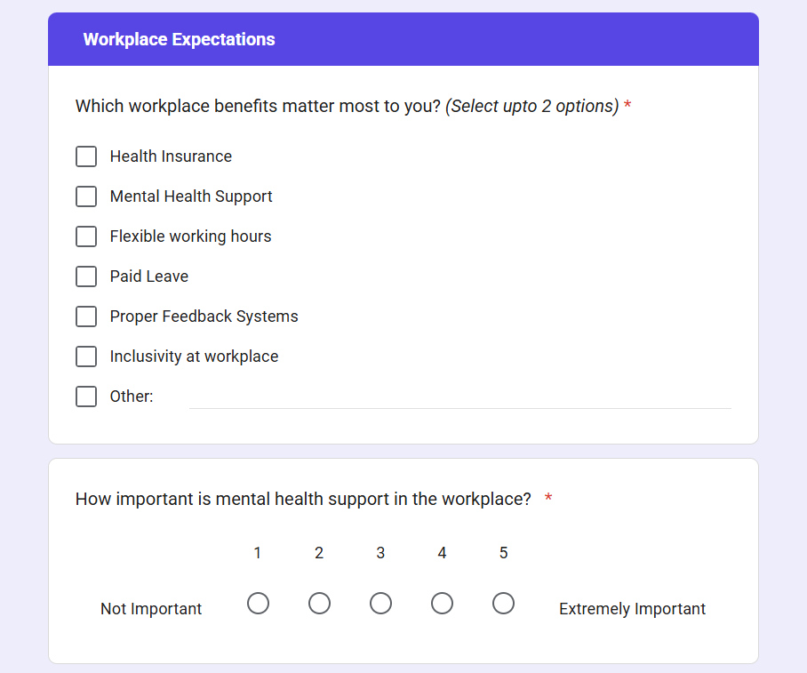
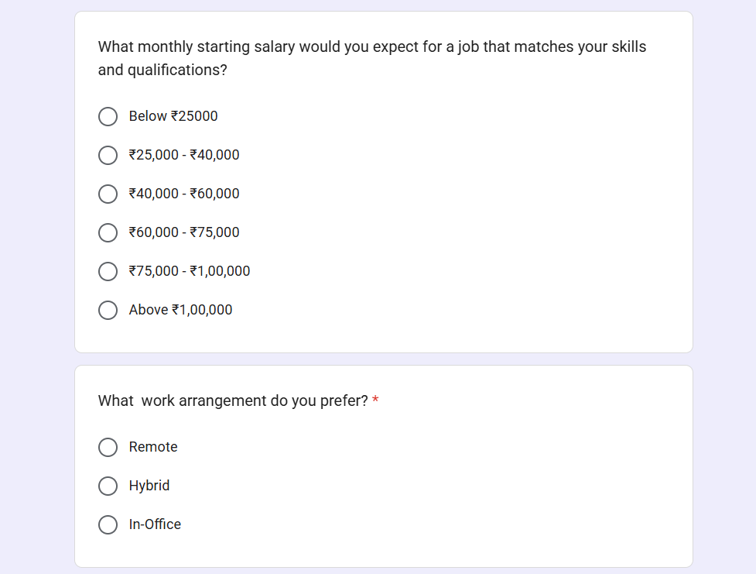
Milestone 3 — Data Collection using Survey
Sample screens from the 19-question Google Form used to collect Gen-Z responses
Survey Introduction
Workplace Expectations
Salary & Work Setup

Slide 7
Milestone 4 — Data Cleaning & Standardisation
Preparing raw survey data for analysis
01
02
03
Removed Duplicates
Handled Missing Values
Standardised Text Values
Identified and removed duplicate timestamp entries to ensure data integrity.
Blank cells in key columns were handled by filling or removing incomplete records.
Inconsistent text values (e.g. 'M', 'Male', 'male') were standardised to a single format.
04
05
06
Fixed Data Types
Cleaned Column Names
Final Validated Dataset
Columns like Pin/Zip Code and Importance of Social Impact were converted to correct numeric types.
Spaces and special characters in column headers were cleaned for easier SQL and Power BI use.
3,611 clean rows and 19 columns — ready for EDA and SQL analysis.

Slide 8
Milestone 5
Exploratory Data Analysis
Answering 5 business questions using pivot tables and charts in Excel

Slide 9
EDA — Career Aspirations & Influencing Factors
Questions 1 & 2 | India respondents
Q1: Most Popular Career Aspirations
Q2: Top Influencing Factors

Slide 10
EDA — Work Environment, Salary & Social Impact
Questions 3, 4 & 5 | India respondents
Q3: Work Environment
Q4: Salary Expectations (3 yrs)
Q5: Social Impact Rating
Hybrid is the top preference (46%)
29% expect above ₹50k within 3 years
73.7% do not require a clear mission statement

Slide 11
Milestone 6
SQL Analysis
Answering 5 deep-dive business questions using MySQL queries
Jayati Singh · KultureHire Learnternship

Slide 12
Milestone 6 — SQL Analysis
5 Business Questions Answered Using MySQL
Q1
What industries/careers is Gen-Z most interested in?
Design & Creative Strategy ranked #1, followed by Data Analyst and Business Operations.
Q2
What are the top factors influencing Gen-Z career choices?
Parents are the #1 influence, followed by World Leaders and Popular Influencers.
Q3
What is the desired work environment for Gen-Z?
Hybrid work dominates — especially setups with more than 15 office days per month.
Q4
How do salary expectations impact career choices?
~30% expect over ₹50k in 3 years. High salary roles (Design, Data, Business Ops) are most sought.
Q5
What role does social impact play in career choices?
Social impact is moderately valued. Most rate it 5/10 — but 78% feel companies' actions don't match their stated missions.

Slide 13
Milestone 7
Excel Dashboard
Building an executive-level dashboard using pivot tables and charts

Slide 14
Milestone 7 — Executive Excel Dashboard
5 business questions visualised using Pivot Tables & Charts
What Was Built
Key Highlights
Industry/career preferences among Indian Gen-Z
Top factors influencing career decisions
Preferred work environment and team setup
Salary expectations at 3-year experience mark
Role of social impact values in career choices
Gender-based slicer for all charts
📊
Pivot Tables
Used to summarise and filter data by multiple dimensions.
🔢
5 Questions Answered
Each question has a dedicated chart with clear labels.
🎛️
Gender Slicer
One slicer filters all visuals simultaneously.
⏱️
Took ~2 Days
Complex manual process compared to Power BI.

Slide 15
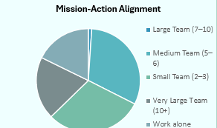
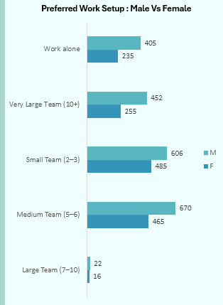
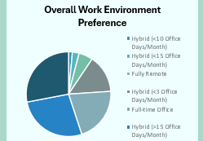
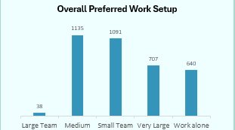
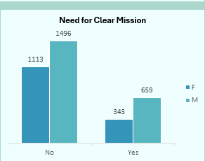
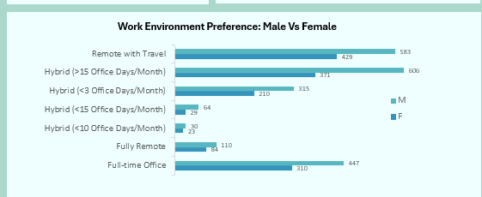
Milestone 7 — Excel Dashboard Charts
Key chart visuals from the executive Excel dashboard
Mission-Action Alignment
Preferred Setup: M vs F
Overall Work Env. Preference
Overall Preferred Work Setup
Need for Clear Mission
Work Env. Preference: M vs F

Slide 16
Milestone 8
Power BI Dashboards
Two focused dashboards — Manager Aspirations & Mission Aspirations

Slide 17
Milestone 8 — Power BI Functional Dashboards
2 Focus-Area Dashboards with KPIs, Charts, and Gender Slicer
Dashboard 1 — Manager Aspirations
Dashboard 2 — Mission Aspirations
KPI: Total Participants & Total Pin Codes
Preferred Manager Style (Horizontal Bar)
Work Environment by Gender (Clustered Bar)
3-Year Job Commitment (Bar Chart)
Preferred Work Setup (Donut Chart)
Gender Slicer (M / F)
KPI: Total Participants & Total Pin Codes
Mission-Action Alignment by Gender (Clustered Bar)
Need for Clear Mission (Horizontal Bar)
Importance of Social Impact — Grouped Chart
Higher Education Aspiration (Donut Chart)
Gender Slicer (M / F)

Slide 18
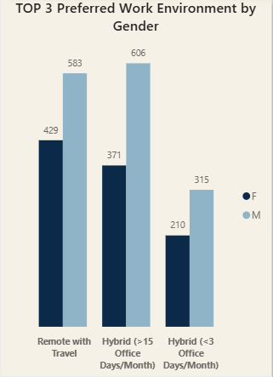
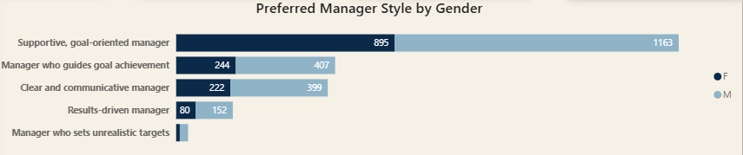
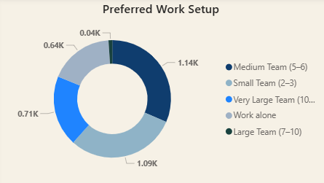
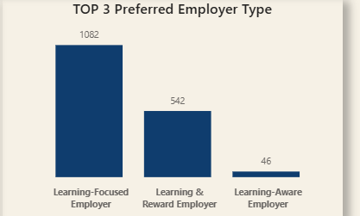
Milestone 8 — Manager Aspirations Charts
Key chart visuals from the Power BI Manager Aspirations dashboard
Top 3 Work Environment by Gender
Preferred Manager Style by Gender
Preferred Work Setup
Top 3 Preferred Employer Type

Slide 19
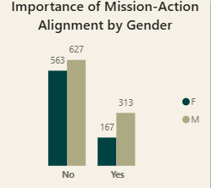
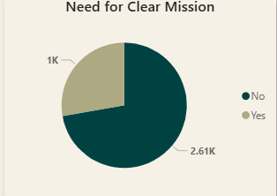
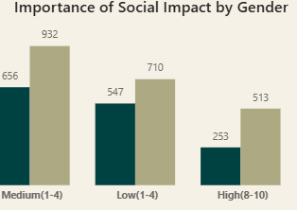
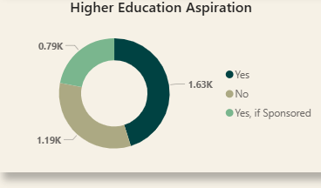
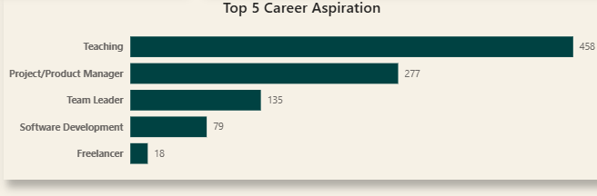
Milestone 8 — Mission Aspirations Charts
Key chart visuals from the Power BI Mission Aspirations dashboard
Mission-Action Alignment by Gender
Need for Clear Mission
Importance of Social Impact by Gender
Higher Education Aspiration
Top 5 Career Aspiration

Slide 20
Key Insights from the Project
What the data tells us about Gen-Z career aspirations
💼
Career Preferences
👨‍👩‍👧
Family Influence is #1
🏠
Hybrid Work Wins
Design & Creative Strategy and Data Analysis are the top career choices for Indian Gen-Z.
Parents are the biggest influencer in career decisions, above social media and celebrities.
46% prefer hybrid work. Fully remote and office-only are both less preferred.
💰
High Salary Expectations
🎯
Mission Matters (but Actions More)
🤝
Supportive Managers are Key
~30% expect over ₹50k in just 3 years of experience, showing a strong ROI mindset.
78% feel company actions don't match their stated missions — trust deficit is real.
Gen-Z overwhelmingly prefers supportive, goal-oriented managers over results-driven ones.

Slide 21
Recommendations for Employers & HR Teams
Actionable steps based on Gen-Z career aspiration data
01
Offer Hybrid Work Arrangements
Flexibility is non-negotiable for Gen-Z. Offer hybrid models with at least 15 days from home.
02
Develop Supportive Managers
Train managers to be goal-oriented and supportive. Avoid micromanagement and unrealistic targets.
03
Be Transparent About Salaries
Clearly outline salary growth paths. Gen-Z expects over ₹50k in 3 years and >₹151k in 5 years.
04
Align Actions with Mission
78% distrust companies whose actions don't match stated values. Walk the talk publicly.
05
Focus on Growth Opportunities
Provide clear promotion paths, cross-functional projects, and skill development programs.

Slide 22
Thank You!
Understanding Career Aspirations of Gen-Z
Jayati Singh

